Slide 1

A.U.R.O.R.A
Analysis of Upstream Risks using Observed Regional Anomalies

Slide 2

Problem Statement
Data analysts often need to study revenue changes in relation to macro-level societal factors (e.g., economic conditions, weather, news events).
But relevant data are scattered across multiple external sources with differing formats and time resolutions.
Analysts must manually retrieve, clean, and align these heterogeneous datasets, a process that is time-consuming, error-prone, difficult to reproduce, and frequently repeated across projects.
Differences in data frequency (daily, weekly, monthly, quarterly) further complicate analysis.

Slide 3

Proposed Solution
We propose a ready-to-use R package that automates the integration of macro-level contextual data with user-provided revenue datasets through a single high-level function call.
The package retrieves data from multiple external APIs, standardizes all sources to a common daily time scale.
The resulting augmented dataset enables efficient visualization, correlation, and trend analysis of revenue alongside macro-level factors
This reduces manual effort while improving reproducibility and analytical efficiency.

Slide 4




APIs
FRED API
GDELT
Open Meteo

Slide 5
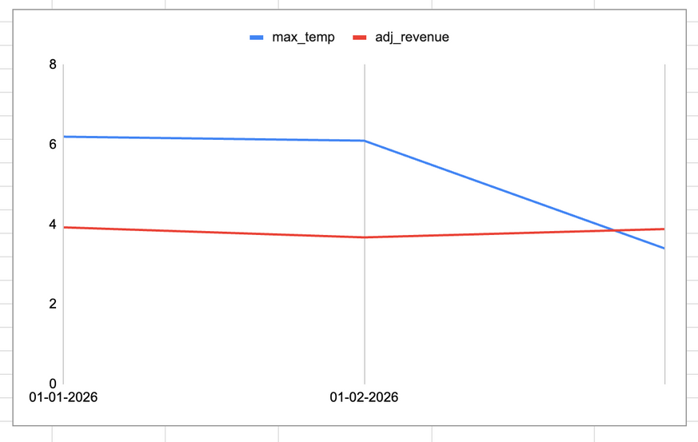
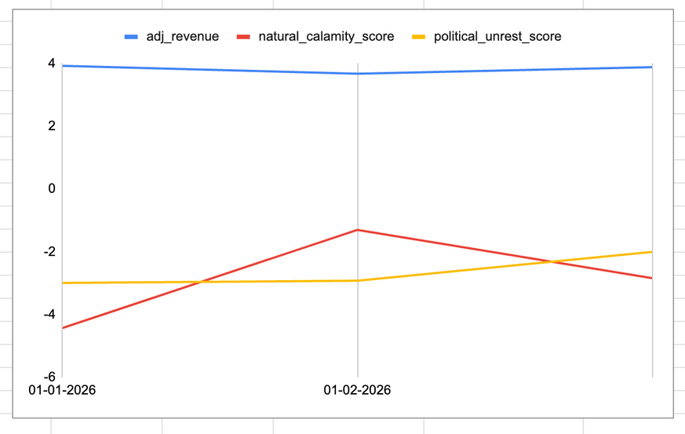
Demo

Slide 6



Impact
The package provides a unified, one-call interface to automatically fetch, align, and integrate heterogeneous macro-level data sources.
No existing industry package provides the full end-to-end capability
It standardizes mixed-frequency macro data into a consistent daily time series using reproducible, built-in transformation rules, eliminating ad-hoc alignment and manual preprocessing.
By drastically reducing data preparation time and improving reproducibility, the solution enables analysts to focus on insight generation, faster trend discovery, and more informed revenue analysis.

Slide 7




Our Team
Zaed Khan
Ilakiya Yuvarani
Karthik Chandran

Slide 8
Thank You

